Slide 1
Digital Circuits and Systems Lecture 10 Synthesis
Tian Sheuan Chang

Slide 2
Synthesis overview
Slides from Prof. Hung Ming Chen

Slide 3
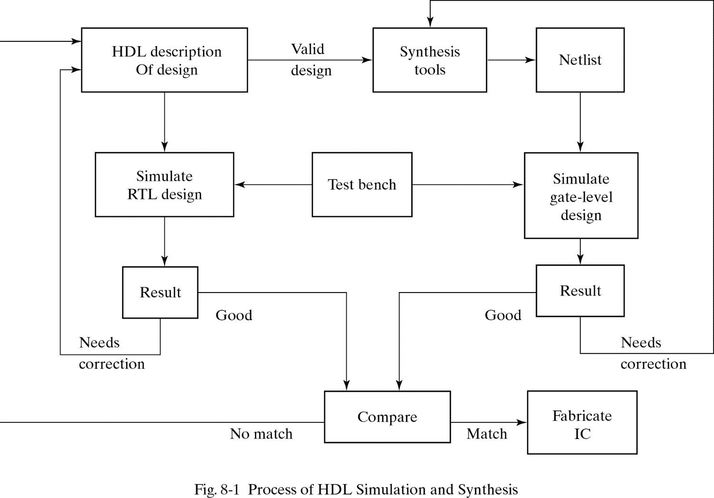
HDL-Based Design Flow

Slide 4
Levels of Design
Notes:
3 domain
Behavior domain : focus on describing function, behavior . Do not care implementation details
Structural domain: focus on interconnection of components
Physical domain: focus on how to manufacture
Abstract level: system, RTL, logic, circuit according to design abstraction
Design usually goes through Behavior Structural and physical by using design aided tools indicated by arrows
Our thesis focus on RTL synthesis

Slide 5
Register Transfer Level Synthesis
Synthesis = Domain Translation + Optimization
Domain
translation
Optimization
(area, timing, power...)
+
--VHDL //Verilog
if(A=‘1’) then if(A==1)
Y<=C + D; Y=C + D;
elseif (B=‘1’) then else if(B==1)
Y<=C or D; Y=C | D;
else Y<=C; else Y=C;
endif
Behavioral domain
Structural domain

Slide 6
Two-Level Logic Optimization
Two-level logic representations
Sum-of-product form
Product-of-sum form
Two-level logic optimization
Key technique in logic optimization
Many efficient algorithms to find a near minimal representation in a practical amount of time
In commercial use for many years
Minimization criteria: number of product terms
Example: F = XYZ + XYZ + XYZ + XYZ+XYYZ
F = XY + YZ

Slide 7
Multi-Level Logic Optimization
Transforms a combinational circuit to meet performance or area constraints
Two-level minimization
Common factors or kernel extraction
Common expression re-subsitution
In commercial use for many years
Example:
f1 = abcd + abce +abcd + abcd +
ac + cdf + abcde + abcdf
f2 = bdg + bdfg + bdg + bdeg
f1 = c (a + x) + acx
f2 = gx
x = d (b + f) + d (b + e)

Slide 8
Technology Mapping
Goal: translation of a technology independent representation (e.g. Boolean networks) of a circuit into a circuit in a given technology (e.g. standard cells) with optimal cost
Optimization criteria:
Minimum area
Minimum delay
Meeting specified timing constraints
Meeting specified timing constraints with minimum area
Usage:
Technology mapping after technology independent logic optimization
Technology translation

Slide 9
Timing Optimization
There is always a trade-off between area and delay
Optimize timing to meet delay spec. with minimum area

Slide 10
RTL Synthesis

Slide 11
Domain Translation
Consistent with data
manipulation functions
x = y op z
Combinational
Circuit
Generation
Input HDL
Description
3-address
Code
Initial
Structural
Netlist
optimization
(area, timing …)
Special Element
Inferences
Consistent with special semantics

Slide 12
Combinational Circuit Generation
computed by control/
data flow analysis
Input HDL
Interconnection binding
Modified
3-address code
Functional unit allocation
Final result

Slide 13
Special Element Inferences
Given an HDL at RTL, three special elements need to be inferred to keep the special semantics in the HDL.
Latch (D-type) inference
Flip-Flop (D-type) inference
Tri-state buffer inference
reg Q;
always@(D or en)
if(en) Q = D;
else Q = 1’bz;
reg Q;
always@(D or en)
if(en) Q = D;
reg Q;
always@(posedge clk)
Q <= D;
Latch is needed!!
Flip-flop is needed!!
Tri-state buffer
is needed!!

Slide 14
Typical Latch Inference
Conditional assignments are not completely specified
Check if the else-clause exists
Outputs conditionally assigned in an if-statement are not assigned before entering or after leaving the if-statement
always@(D or S)
if(S) Q = D;
always@(S or A or B)
begin
Q = A;
if(S) Q = B;
end
Infer latch
for Q
Do not infer latch
for Q

Slide 15
Typical Latch Inference
Unreasonable limitations on coding style
always@(a or en)
if(en) x=a;
always@(a or en)
if(en) x=a;
else x=x;
Latch description
Wrong
circuit!

Slide 16
Terminology
Clocked statement: edge-triggered always statement
Simple clocked statement
e.g., always @ (posedge clock)
Complex clocked statement
e.g., always @ (posedge clock or posedge reset)
Flip-flop inference must be conducted when synthesizing the clocked statements

Slide 17
Typical Flip-Flop Inference on Simple Clocked Statements
Infer a flip-flop for each variable being assigned in the simple clocked statement
used after defined
connected to input of x
used before defined
connected to output of z

Slide 18
Typical Flip-flop Inference on Complex Clocked Statements
Require the following syntactic template
An if-statement immediately follows the always statement
Each variable in the event list except the clock signal must be a selective signal of the if-statement
Assignments in the blocks B1 and B2 must be constant assignments (e.g., x=1, etc.)
always @ (posedge clock or posedge reset or negedge set)
if(reset) begin B1 end
else if ( !set) begin B2 end
else begin B3 end

Slide 19
Typical Flip-flop Inference on Complex Clocked Statements
Reset flip-flop
The output Q changes to reset value i if
The reset signal R = 1
If R = 0, reset flip-flop = D flip-flop

Slide 20
Typical Flip-flop Inference on Complex Clocked Statements
An example
Disadvantages
Syntactic template results in unreasonable limitations in coding style
always @ (posedge clk or posedge R)
if(R) Q = 0;
else Q = D;
always @ (posedge clk or posedge R)
begin
Q = D;
if(R) Q = 0;
end
Non-synthesizable

Slide 21
Typical Tri-state Buffer Inference
If a data object Q is assigned a high impedance value ‘Z’ in a multi-way branch statement (if, case, ?:)
Associated Q with a tri-state buffer
If Q associated with a tri-state buffer has also a memory attribute (latch, flip-flop)
Real hardware cannot propagate Hi-Z (Hi-Z propagation problem)
Place two memory elements to the control and the data inputs of tri-state buffer

Slide 22
Synthesis Scripts

Slide 23
Synthesis in design flow
Specification
Algorithm Development (C/C++)
Architecture Design
RTL Coding
Synthesis
Gate-level Simulation
Timing/Area/Power Analysis
Auto-Place and Route
Post Simulation
Synthesis
Tool: Design compiler (synopsys)
Goal
Model translation from RTL to gate-level
Technology mapping
Constrained optimization
Timing/area/power analysis
Tool: Design Compiler, PrimeTime, PrimePower (synopsys)
Goal
Hardware performance verification
Gate-level simulation
Tool: ncverilog (cadence)
Goal
Functionality verification

Slide 24
Data flow in Design Compiler
What you need to prepare:
RTL codes
Synthesis script
Gate-level testbench
RTL code
RTL code
RTL code
(.v)
Synthesis script (tcl)
DesignWare Library
Design Compiler
Technology Process Library
Performance report
Performance report
Performance Report
Memory Model
(.db)
Gate-level Testbench
(.v)
Gate-level Model
(.v)
Standard Delay Format file
(.sdf)
Gate-level Library
ncverilog
PASS or FAIL

Slide 25
Introduction to Design Compiler
Design Compiler (dc)
Kernel of synthesis tool
Command-line interface
Easy to iterative compiling
dc_shell: original command of DC
dc_shell-t: dc_shell + tcl (tool command language)
Menu-driven interface
Friendly GUI interface
Design Vision (dv) supports dc_shell and dc_shell-t
Design Analyser (da) only supports dc_shell
Open tools by command
dv &
da &
Before learning DC, you should learn the tcl first.

Slide 26
Synthesis Script in DC

Slide 27
Flow
1. Specify Library
2. Read Design
4. Define Design Environment
5. Set Design Constraint
6. Set Compile Strategy
7. Optimization
8. Analyze Design Problems
10. Save Design
9. Change Naming Rules
3. Create Clock
First, select a semiconductor vendor
TSMC
UMC
others
Default setting: .synopsys_dc.setup
Search directory
Synopsys root directory
Home directory
Working directory (highest priority)
3 files are executed automatically.
Viewed by command ls –la

Slide 28
1. Specify library
Search path
lists all the related directories of design and libraries.
Syntax: set search_path {“…“}
Link library
lists all technology process libraries with various timing condition.
Syntax: set link_library {“wc.db” “bc.db”}
Target library
selects libraries from link_library.
Syntax: set target_library {“wc.db” “memory.db”}
Symbol library
defines symbols of schematic view for DV or DA.
Syntax: set symbol_library file.sdb
DesignWare library
defines built-in operators in Synopsys
Syntax: set synthetic_library {“dw_foundation.sldb”}

Slide 29
Related libraries in our Lab
Technology process library
Path: /CAD/UMC0090/UMC90_CELL/UMC90_CELL/SP_RVT_C05/synopsys
File: l90sprvt_wc.db, l90sprvt_typ.db, l90sprvt_bc.db
Memory library
Path: ../lib
File: memory.db
Symbol library
Path: /CAD/synopsys/synthesis/cur/libraries/syn
File: generic.sdb
DesignWare library
Path: /CAD/synopsys/synthesis/cur/libraries/syn
File: dw_foundation.sldb
All the libraries’ path and name will be changed due to different technology processes and different tool versions.

Slide 30
Set max/min libraray
Set an alternate library for min/max delay analysis.
Command:
set_min_library max_lib –min_verison min_lib
Libraries should be described in link_library.
Priority of delay value
Delay in min library (higher)
Delay in max library
set BEST_LIB(slow.db) fast.db
…
if [array exist BEST_LIB] {
echo "setting min/max libraries."
foreach lib_w [array names BEST_LIB] {
set lib_b $BEST_LIB($lib_w)
set_min_library $lib_w -min_version $lib_b
}
}

Slide 31
2. Read design
Supported format
Verilog, VHDL, SystemVerilog
Synopsys internal database format (.db, .ddc)
Berkeley Escpresso format (.pla)
Method1:
analyze (only HDL)
Read HDL source files, check errors.
Create and store HDL-independent intermediate objects.
elaborate (only HDL)
Translate intermediate objects into technology-independent design (GTECH).
Load parameters in HDL source files.
Replace DesignWare components.
Execute link command to resolve design references.
Method2:
read_file
Read files with selected format.
Execute the same steps in analyze and elaborate (without link and loading param.).
Do not create intermediate objects (default).
Ex1: read_file –rtl -format verilog $RTL
Ex2: read_file –netlist -format verilog $GATE_LEVEL

Slide 32
Set current design
Only one design can be set as current design for optimization.
Setting current design ways:
Automatic setting after command
read_file
elaborate
Direct command:
current_design design_name

Slide 33
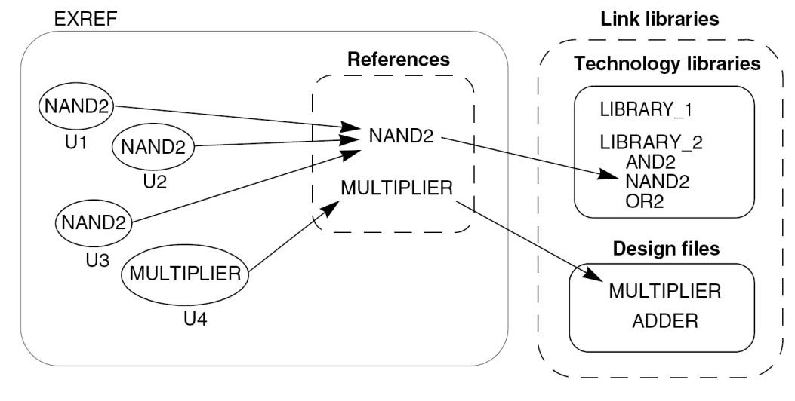
Link design
Liking design (resolving references) is to connect all library components and design its references.
Command:
link
Performed steps:
libraries to reference
local_link_library (highest priority)
link_library
search_path (lowest priority)
reference to design

Slide 34
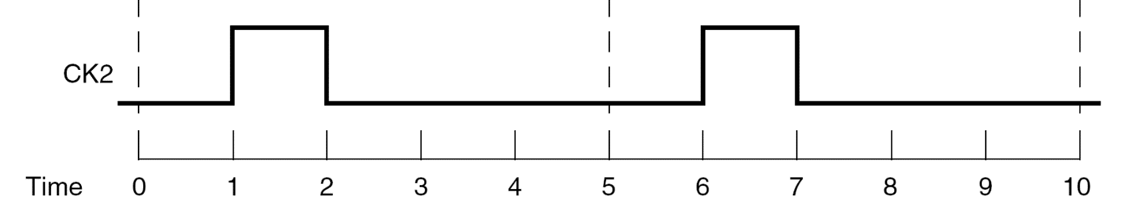
3. Create clock
Creating clock
Command:
create_clock -name name -period value -waveform {Tr, Tf} port
Default clock characteristics (ideal clock)
0 delay at clock port
0 propagation delay
0 transition delay
0 uncertainty
Ex:
create_clock –period 5.0 –waveform {1.0, 2.0} [get_ports CLK2]

Slide 35
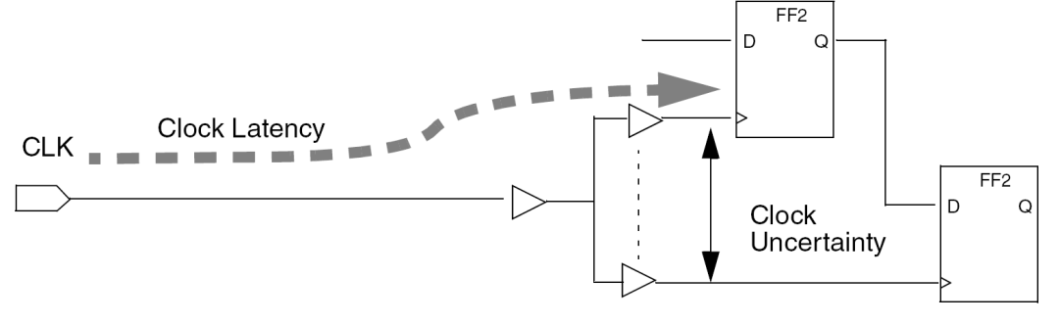
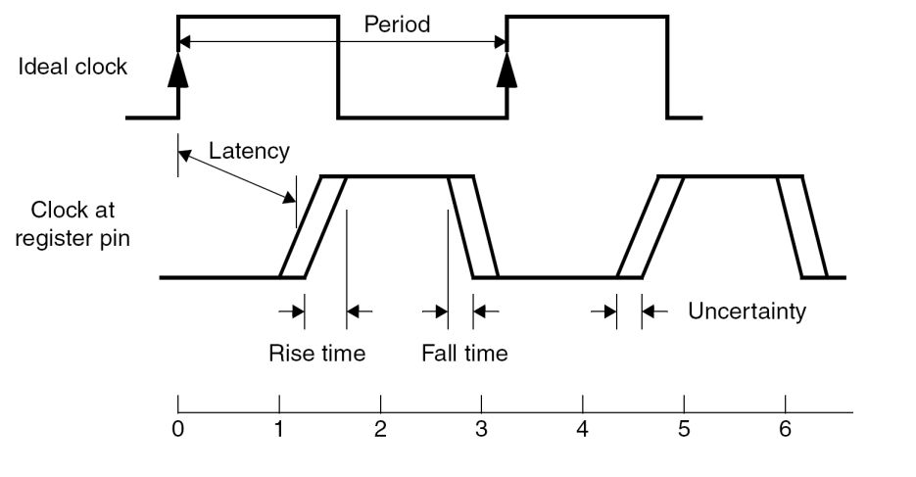
Clock network effects
Clock latency
consists of
Source latency: clock source to clock pin
Network latency: clock pin to register clock pin
Clock uncertainty (skew)
Maximum differences between the arrival of clock signals at registers
Transition time
It takes for a signal to change from low to high, or high to low.
Transition time of input affects
Delay to output
Transition time of output

Slide 36
Clock latency: network latency
Network latency
Command:
set_clock_latency delay [get_clocks clk]
set_clock_latency -fall delay [get_clocks clk]
set_clock_latency -rise delay [get_clocks clk]
Option
Rise: latency setting to only rising edges of clocks
Fall: latency setting to only falling edges of clocks

Slide 37
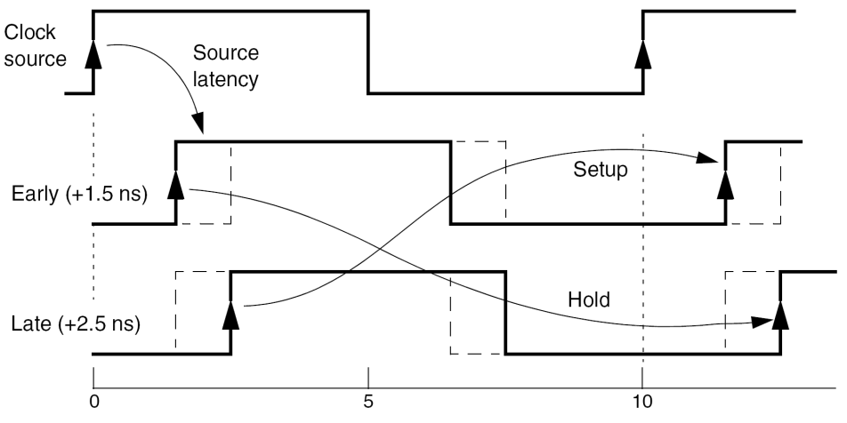
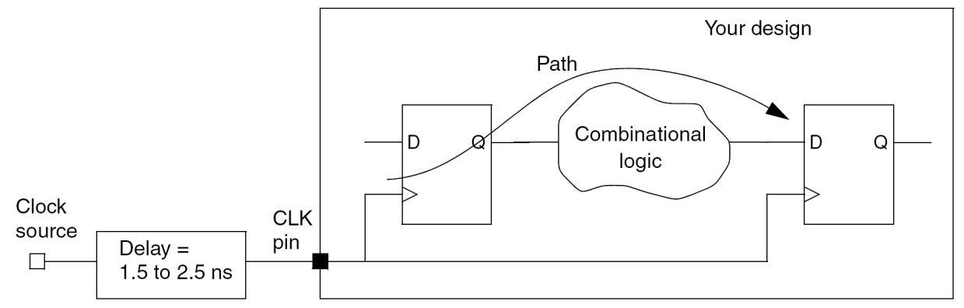
Clock latency: source latency
Source latency
Command:
set_clock_latency delay –source [get_clocks CLK]
set_clock_latency delay –source -early [get_clocks CLK]
set_clock_latency delay –source -late [get_clocks CLK]
Option
-early: for setup time checking
-late: for hold time checking
Ex
set_clock_latency 1.5 –source –early [get_clocks CLK]
set_clock_latency 2.5 –source –late [get_clocks CLK]

Slide 38
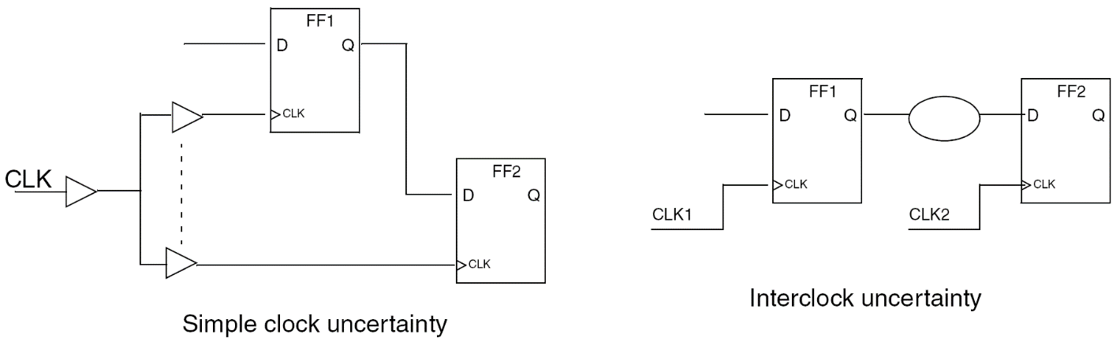
Clock uncertainty
Difference in delay due to clock tree or multiple clock domains.
Two uncertainties:
Single clock uncertainty
set_clock_uncertainty delay[get_clocks CLK]
Interclock uncertainty
set_clock_uncertainty delay –from [get_clocks CLK1] –to [get_clocks CLK2]

Slide 39
Clock transition time
Command:
set_clock_transition delay [get_clocks CLK]
set_clock_transition delay –fall [get_clocks CLK]
set_clock_transition delay –rise [get_clocks CLK]
Option
Rise: transition time setting to only rising edges of clocks
Fall: transition time setting to only falling edges of clocks

Slide 40
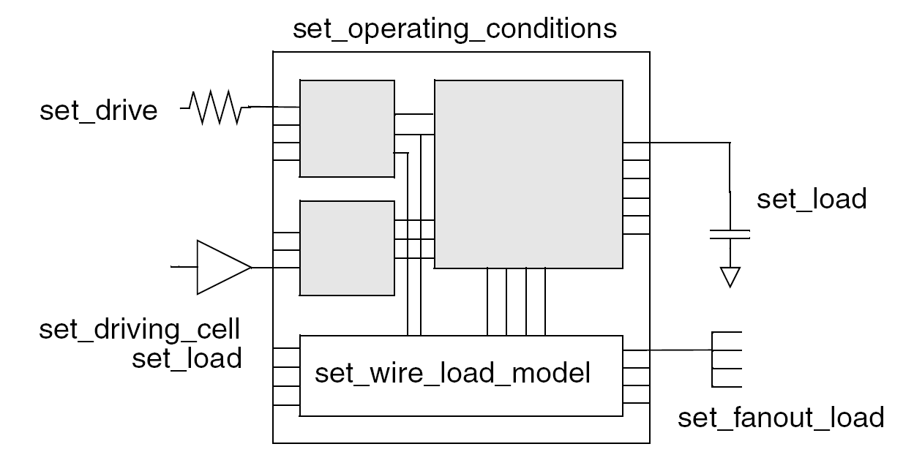
4. Define design environment
Design environment
Operating condition
temperature
supply voltage
manufacturing process
Wire load model
System interface characteristics
input drive
input/output load
fanout load

Slide 41
Operating condition
General operating conditions in technology process
best case (fast)
typical case
worst case (slow)
List available operation condition (library should be link before.)
Command
read_file my_lib.db
report_lib my_lib
Specify operating condition
Command
set_operating_conditions op_name -library library_name
set_operating_conditions -max wost_op -min best_op
set WORST_OP "slow"
set BEST_OP "fast“
…
if [array exist BEST_LIB] {
set_operating_conditions -max $WORST_OP -min $BEST_OP
} else {
set_operating_conditions -max $WORST_OP
}

Slide 42
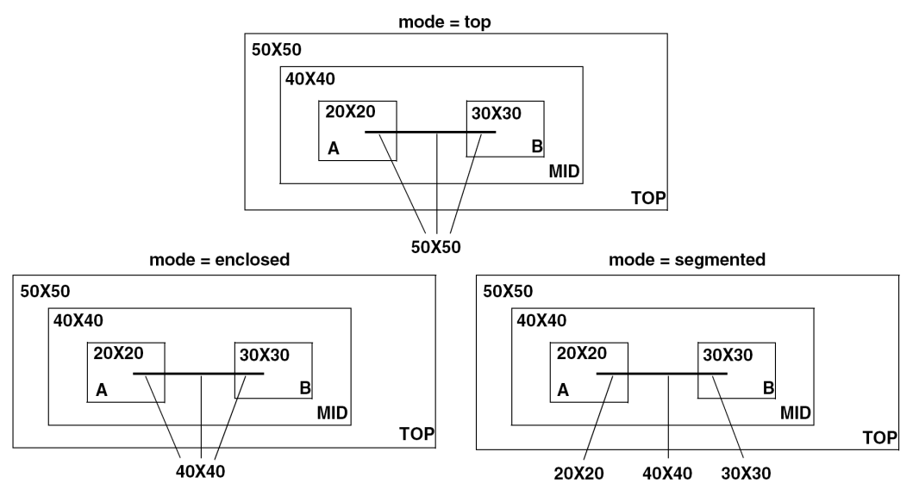
Wire load model
Wire load model is defined in library.
Wire effect estimation
wire length
fanout
3 Hierarchical wire load modes
Top (most rough estimation)
no subdesigns’ wire load models
Enclosed
depends on its level
Segmented (most accurate estimation)
depends on its positions.

Slide 43
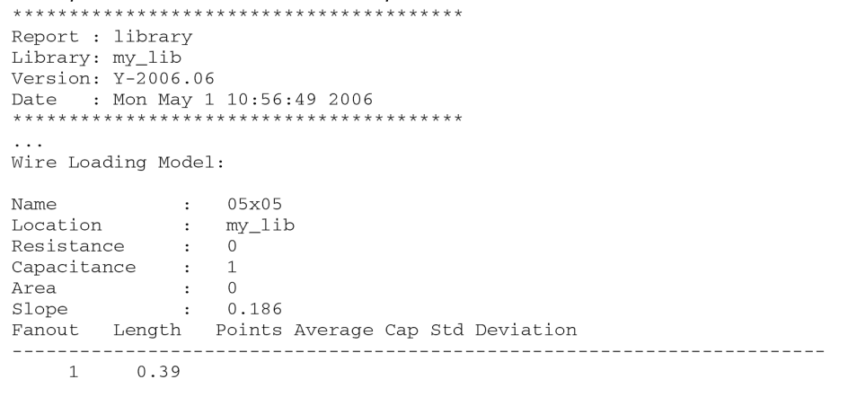
Wire load mode (cont.)
List available wire load models
Command
read_file my_lib.db
report_lib my_lib
Specify wire load models
Command
set_wire_load_model -name model_name -library lib_name
set_wire_load_mode mode_name

Slide 44
Concept of transition time, drive strength
Transition time
is set as constant(rough model).
is set as function of RC (accurate model).
Tobj = Tprev + R x C
Drive strength (default: infinite)
Drive strength = 1 / R
The selected cell should have the drive strength more than required one.
T_{prev}
Transition time T_{obj}
T_{prev}
T_{obj}
R
C

Slide 45
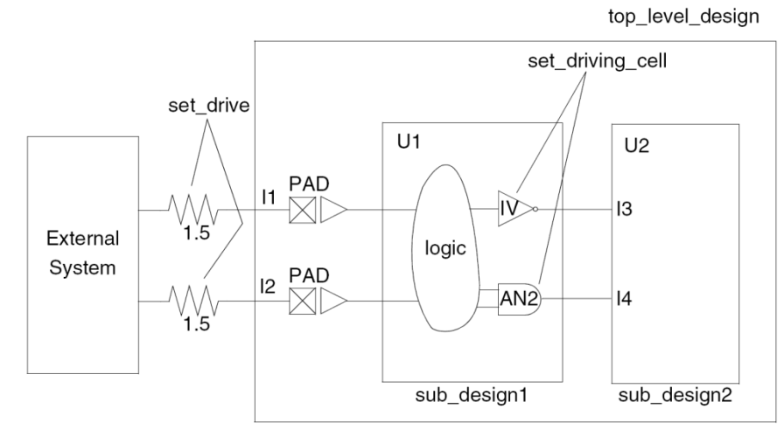
System interface
Drive cell
is defined in technology library.
Command: set_drive_cell –lib_cell cell IN
Drive strength
is set for the inputs of design.
Command: set_drive R IN
Input transition delay
Rough setting
Command: set_input_transition time IN
Load on input/output (capacitance)
Output load: is used to select proper cell drive strength
Input load: is used to model transition delay
default: 0
command: set_load C IN/OUT/NET

Slide 46
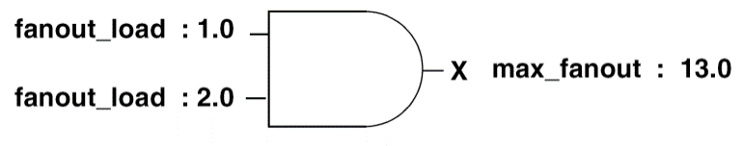
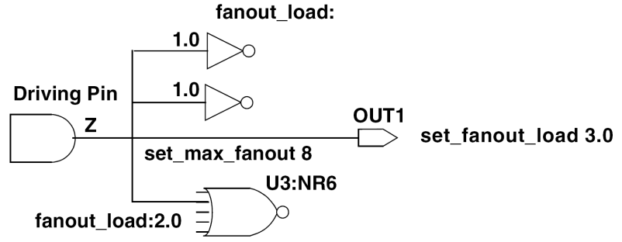
System interface: input/output port
Fanout effect
No unit
Fanout_load and max_fanout of each cell are defined in technology library.
Constraint
∑fanout_load <= max_fanout
Command: set_fanout_load value OUT

Slide 47
5. Set design constraints
Two types of constraints in DC
Design rule constraints (precedence)
include
max. transition time
max. fanout
max/min. capacitance
are defined by technology library.
can be defined more restrictively by designer.
Optimization constraints
include
area
speed
are defined by designer.

Slide 48
Design rule constraints
Max transition time (ns)
is the longest time to drive a pin and change its value.
command: set_max_transition time IN/OUT/design
Max fanout (no unit)
∑fanout_load <= max_fanout
A high drive strength cell has higher fanout.
command: set_max_fanout value IN/design
Max capacitance
is total capacitive load(net) that an output pin can drive.
command: set_max_capacitance C IN/OUT/design
Min capacitance
specifies min load that a cell drive.
command: set_min_capacitance C IN
Typical design rule scenarios
set_max_fanout + set_max_transition
set_max_fanout + set_max_capacitance

Slide 49
Optimization constraints
Timing constraint
sets input delay on pins or input/output ports relative to a clock signal.
command: set_input_delay delay –clock clock in
command: set_output_delay delay –clock clock out
Max area
unit: number of gates, instead of physical area
ignored components in optimization
unknown components
components with unknown area
technology-independent generic cells
command: set_max_area area
area = 0 (as small as possible)

Slide 50
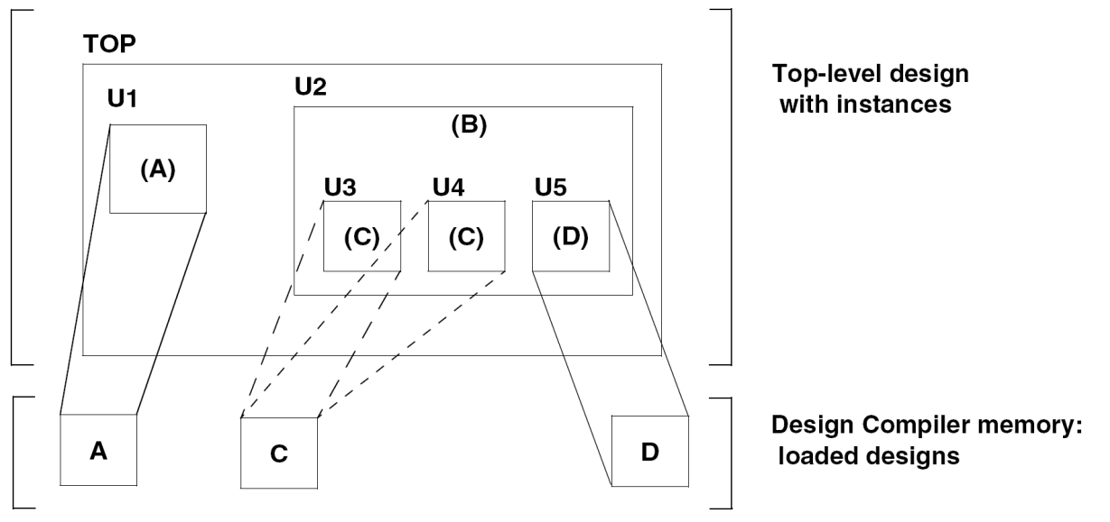
6. Select compile strategy
Three compile strategies
Top-down compile
Bottom-up compile
Mixed compile
Methods for resolving instances
Uniquify method
Compile-once-don’t-touch method
Ungroup method

Slide 51
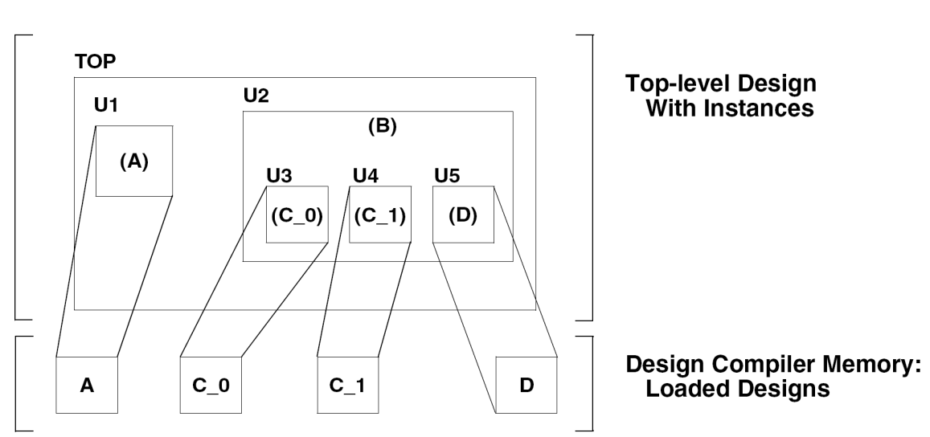
Uniquify method
Create a unique design for each instance, even if it is resolved from an identical reference.
Command:
uniquify
uniquify –cell cell_name
Pros and cons
more memory
longer compile time
better performance
Hierarchy in cell is preserved.

Slide 52
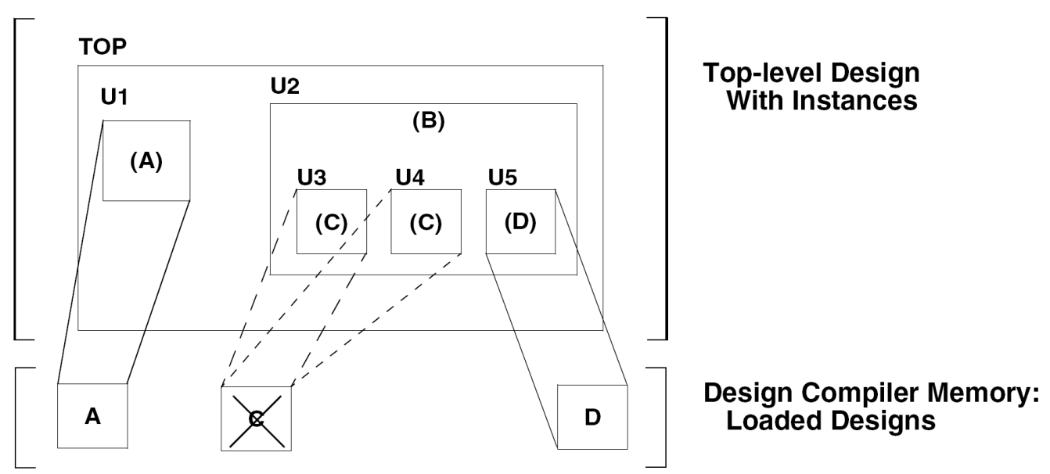
Compile-once-don’t touch method
Pre-compile sub-designs, and set it as don’t touch for compiling entire design.
Command
set_dont_touch cell_list
Pros and cons
less memory
shorter compile time

Slide 53
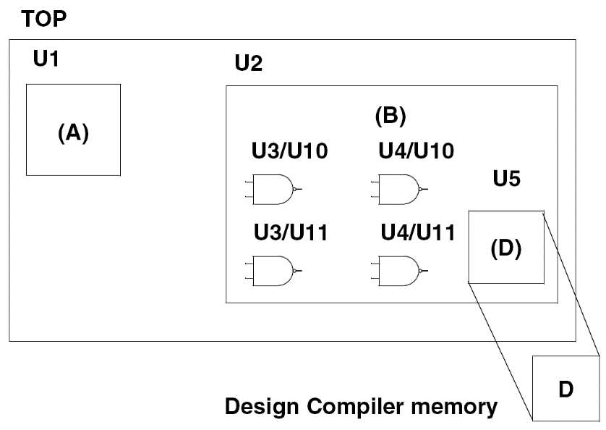
Ungroup method
The same effect as uniquify method but it removes hierarchical levels.
Command
ungroup cell_list
Pros and cons
more memory than compile-once-don’t-touch
longer compile time than compile-once-don’t touch
better performance
It removes user-defined design heirarchy
Hierarchy in cell is broken.

Slide 54
7. Optimization
DC performs 3 optimization levels
Architectural optimization on HDL descrition
Sharing common expressions
Sharing resources
Selecting DesignWare implementations
Reordering operators
Identifying arithmetic expressions for data-path synthesis (DC-ultra)
Logic-level optimization on GTECH netlist
Structuring
Flattening for conditional logic
Gate-level optimization on technology-dependent netlist
Technology mapping
Delay optimization
Design rule fixing
Area optimization

Slide 55
compile
Default synthesis algorithm
command
compile
compile –map_effort median –area_effort median
Advanced synthesis algorithms
High-performance designs
compile_ultra
Maximum performance
Minimum area
Data path
More information
Refer to “Design Compiler Optimization Reference Manual”

Slide 56
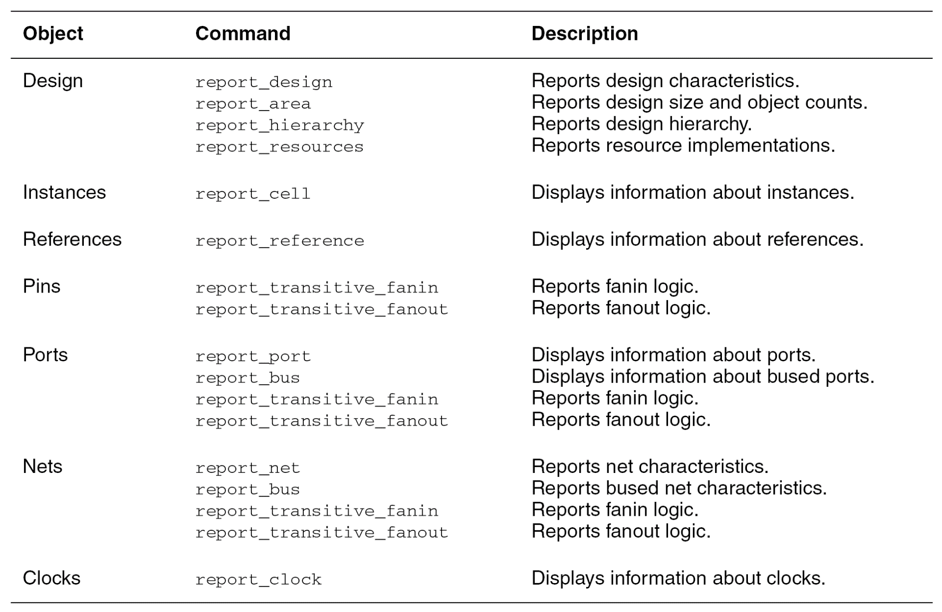
7. Analyze design problems

Slide 57
Area
****************************************
Report : area
Design : JBF
Version: B-2008.09-SP2
Date : Wed Dec 23 20:38:36 2009
****************************************
Library(s) Used:
……
Number of ports: 169
Number of nets: 70269
Number of cells: 55211
Number of references: 205
Combinational area: 669475.743010
Noncombinational area: 1593732.288294
Net Interconnect area: 13561542.382202
Total cell area: 2263208.031303
Total area: 15824750.413506
Analyzing area
Combinational area
Non-combinational area
Total area
Report for current design
report_area
Report for current design across the hierarchy
report_area -heirarchy

Slide 58
Timing
report_design
Shows operating conditions, wire load model and mode, timing ranges, internal input and output, and disabled timing arcs.
check_timing
Checks for unconstrained timing paths and clock-gating logic.
report_port
Shows unconstrained input and output ports and port loading.
report_timing_requirements
Shows all timing exceptions set on the design.
report_clock
Checks the clock definition and clock skew information.
report_path_group
Shows all timing path groups in the design.
report_timing
Checks the timing of the design.
Slack should be 0 or positive.
report_constraint
Checks the design constraints.
report_delay_calculation
Reports the details of a delay arc calculation.

Slide 59
redirect command
Dump the result of a command into a file
Command:
redirect output_file {command}
Ex
redirect [format "%s%s" $TOP "_syn_area.rpt"]{report_area}
redirect [format "%s%s%s" "REPORT/" $TOP "_syn_min_timing.rpt"] { report_timing -delay min -max_paths 10 }
redirect [format "%s%s%s" "REPORT/" $TOP "_syn_max_timing.rpt"] { report_timing -delay max -max_paths 10 }
redirect [format "%s%s%s" "REPORT/" $TOP "_syn_area.rpt"] { report_area }
redirect [format "%s%s%s" "REPORT/" $TOP "_syn_constraint.rpt"] { report_constraint -all_violators -verbose }
redirect [format "%s%s%s" "REPORT/" $TOP "_syn_resources.rpt"] { report_resources -hierarchy }

Slide 60
8. Change naming rule
Goal
Change naming rule in netlist to avoid confliction in APR.
Variables
bus_inferface_sytle
individual bits of bus
bus_naming_style
individual port member, net member, or cell instance
hdlout_internal_busses
internal bused nets by parsing the names of the nets.
set bus_inference_style {%s[%d]}
set bus_naming_style {%s[%d]}
set hdlout_internal_busses true

Slide 61
Change naming rule (cont.)
change_name
Changes the names of ports, cells, and nets in a design.
-hierarchy: all names in the design hierarchy are to be modified.
-rule verilog: bulit-in verilog naming rules
-rule name_rule: user-defined naming rules
define_name_rules object …
-allowed: allowed charaters
-max_length: allowed max length of name
-map: replace string in name
Ex: replace \*cell*\ by cell
change_names -hierarchy -rule verilog
define_name_rules name_rule -allowed {a-z A-Z 0-9 _} -max_length 255 -type cell
define_name_rules name_rule -allowed {a-z A-Z 0-9 _[]} -max_length 255 -type net
define_name_rules name_rule -map {{"\*cell\*", "cell"}}
change_names -hierarchy -rules name_rule

Slide 62
9. Save design
database (.db)
Command: write –hierarchy –format db –output file.db
netlist (.v)
IEEE standard Verilog
Command: write –hierarchy –format verilog –output file.v
standard delay format (.sdf)
Delay model for gate-level simulation
Command: write_sdf –context verilog –version 1.0 file.sdf
standard parasitic extraction format(.spef)
Netlist with RC information
Command: write_parasitics –format reduced –output file.spef
-format reduced: one resistance and one capacitance for net model
Synopsys design constraints (.sdc)
Command: write_sdc file.sdc

Slide 63
Gate-level simulation
Command
ncverilog testbench –v tech_model.v +access+r
tech_model.v
Path: /CAD/UMC0090/UMC90_CELL/UMC90_CELL/SP_RVT_C05/verilog
File: l90sprvt.v

